Slide 1
Cellular reaction to an injury
DR.SUADAD ASIM ASS.PROFF.DERARTMENT OF PATHOLOGY , BASRHA MEDICAL COLLEGE

Slide 2
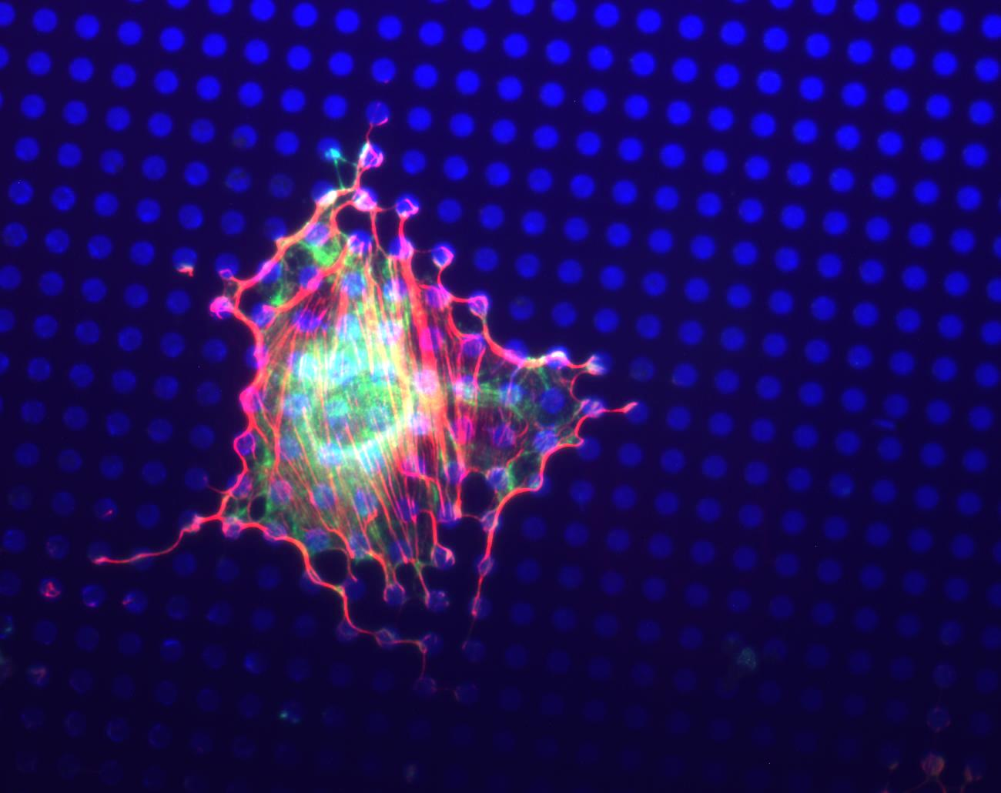
CELL ADAPTATIONS
CELL INJURY
CELL DEATH

Slide 3
REFRENCES
ROBBINS BASIC PATHOLOGY NINTH EDITION

Slide 4
LECTURE ONE
Objectives
Overview of cellular responses to stress and noxious stimuli
causes of cellular injury
Cell adaptation ( atrophy ,hypertrophy ,hyperplasia and metaplasia )

Slide 5
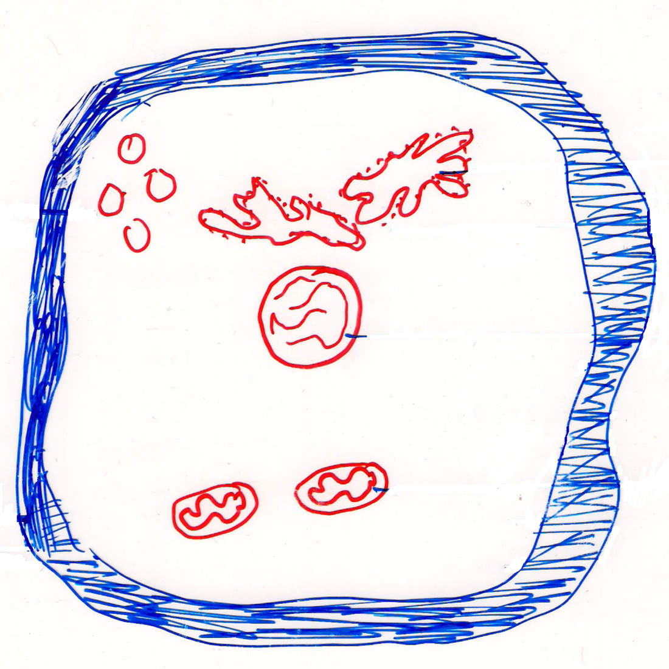
ER
lysosomes
Ribosomes
Mitochondria
Nucleus
Normal Cell

Slide 6
WHAT IS
HOMEOSTASIS

Slide 7
Cells are active Participants in their environment.
Normal homeostasis
│
Normal cells Environment
(retain their function and
Structure and can accommodate
Changes)

Slide 8
When there is physiological
stimuli or pathological stress
Within accommodative Exceed accommodative
capacity capacity
cells retain their function cell injury
and viability by (Adaptation)
reversible
irreversible
(cell degeneration)
(cell death)
necrosis,apoptosis
Hyperplasia
Metaplasia
Atrophy
Hypertrophy

Slide 9
The responses of cardiac muscle to different types of stress

Slide 10
INJURY CAUSES
Hypoxia, (decreased O2)
PHYSICAL Agents
CHEMICAL Agents
INFECTIOUS Agents
Immunologic
Genetic
Nutritional
Aging
Notes:
The usual suspects are always suspected in carcinogenesis, teratogenesis, inflammations, or, really, any disease in general.
So just as you always tend to think of diseases as inflammatory, neoplastic, degenerative, you should always think of causes as physical, chemical, and infectious.

Slide 11
Causes of cell injury
1- hypoxia or O2 defeciency (most common) and important cause
* Ischemia reduced blood supply to tissue
* Inadequate oxygenation of the blood
Example
* Pneumonia
* Reduction in O2 carrying capacity of the blood as in anemia

Slide 12
2- Chemical agents
* Excess salts or sugar, can derange the osmotic environment
* Air pollutants ,insecticides ,asbestos
* Therapeutic drugs can cause cell or tissue injury in a susceptible patient or if used excessively or inappropriately
3- Infectious Agents
* Viruses
* Bacteria
* Fungi
* Parasite

Slide 13
4- Immunological
* Anaphylaxis (reaction to foreign body or drugs).
* Auto immune diseases (response to self Antigen)
5- Genetics
* Down syndrome
* Sickle cell anaemia

Slide 14
6- Nutritional
* Deficiencies ● → protein
Carbohydrate
Vitamins
* Excess ● → Fat (obesity)
Atheroslerosis (lipid in B.V) _ narrowing

Slide 15
7- Physical Agents
* Trauma
* Extremes of temperature (cold or hot)
* Radiation
* Electric schock
8- Aging
Cellular aging is the result of a progressive decline in the life span and functional capacity of cells
Has an important health consequences, increase the risk for chronic diseases such as Alzheimer ,cancer and ischemic heart disease

Slide 16
Adaptation
IS reversible change in the number , size, phenotype, metabolic activity, or function of cells in response to changes in the environment.
1- Atrophy is reduction in the size of an organ or tissue due to ↓ in the size of parenchymal cells.
Causes
A . Physiological
e.g * Atrophy of gonads (ovaries) after menopause
* Atrophy of thymus after puberty
* Atrophy of brain as an aging process

Slide 17
B. Pathological
* Starvation → there is depletion of CHO, fat stores and protein,)
e.g. Cancer
Ischemic → due to ↓ blood supply
e.g Atherosclerosis ─in renal artery → shrinkage and small kidney
cerebral artery → brain atrophy.

Slide 18
☻ Disuse atrophy
Prolonged diminished functional activity
E.g. wasting of limb muscles after fracture
☻ Neuropathic atrophy
Damage to nerve supply leading to wasting of the muscle, e.g, poliomyelitis.
☻ Post – irradiation atrophy
Due to chromosomal damage which interfere with mitosis
☻ Endocrine atrophy
Hypopituitarism may lead to atrophy of the thyroid, adrenals and gonads.
☻Pressure atrophy
E.g. pressure of a tumor on adjacent tissues
☻ Idiopathic (unknown causes) e.g. myopathies

Slide 19
2- Hypertrophy increased in the size of organ or tissue due to increase in the size of paranchymal cells
A. Physiological
e.g. * enlarged size of skeletal muscles in athletes
B . Pathological
* Hypertrophy of Cardiac muscles as in left ventricular hypertrophy in systemic hypertension

Slide 20
3- Hyperplasia increase in the size of organ or tissue due to increase in the number of parenchymal cells
A. physiological
e.g. * Hormonal as in female breast at puberty , pregnancy and lactation
* Proliferative changes in endometrium after each menstrual cycle.
B- Pathological
* e.g. increase estrogen causes endometrial hyperplasia ,exogenous such as in females taking contraceptive pills or endogenous such as in estrogen secreting ovarian tumors

Slide 21
4- Metaplasia (meta = transformation) is defined as reversible change in which one adult cell type ( epithelial or mesenchymal) is replaced by another adult cell type better able to withstand the adverse environment ,often in response to chronic irritation , may results in reduced functions or increased propensity for malignant transformation
Types
A. Epithelial
● Bronchial epithelium in heavy smokers
ciliated columnar →squamous
● Bilharzial infection of urinary bladder
Transitional → squamous
B. Mesenchmal
e.g. bony metaplasia in fibrous tissue .

Slide 22
THANK YOU

